Slide 1
Tanzanian Water Wells
Michael Mahoney

Slide 2

Business Understanding
The big picture
How should the program organize new construction and rehabilitation going into the future
Understand the overall status of wells
What do we have and how did we get here.
Our target variable in this case is the functionality of individual wells
Modeling as a suedo-auditing system
Managing maintenance and new construction
Finding patterns that will give insight into what wells are likely to fail in the short term
When well construction must occur, how to mitigate the risk of non-functionality

Slide 3
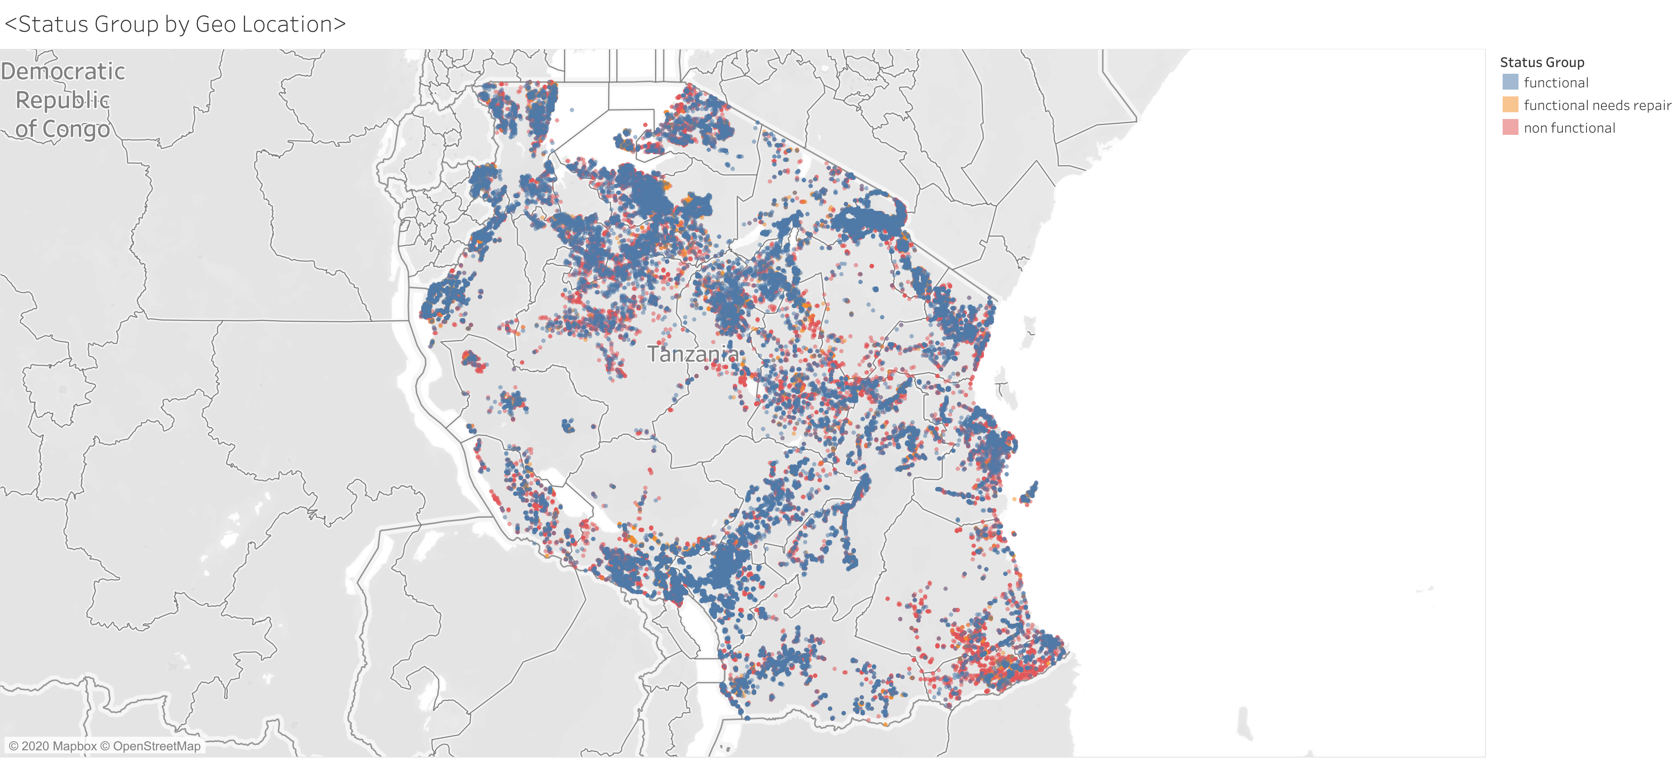
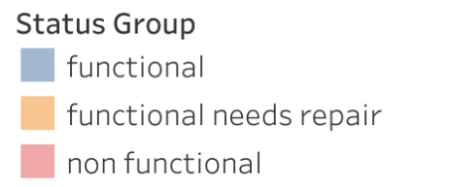
There’s Water Everywhere…
This is an overview of the various status groups by geographic location

Slide 4
Data Understanding
Data Details:
Size: Originally 59000 x 40
Missing Data : Less than 5% missing overall
Data Quirks:
Features: Vast Number of Unique Categorical Features
Place Holder values: Several Columns had existing imputed data
Feature Engineering:
Categorical Columns with thousands of unique entries were binned into groups with similar frequencies
Rare Labels: Incredibly rare labels were absorbed into existing “other” classes within each column
Datetime: Datetime objects were re-engineered into separate columns. Categorical columns for months, day of the week and continuous columns for the calendar day and year.

Slide 5
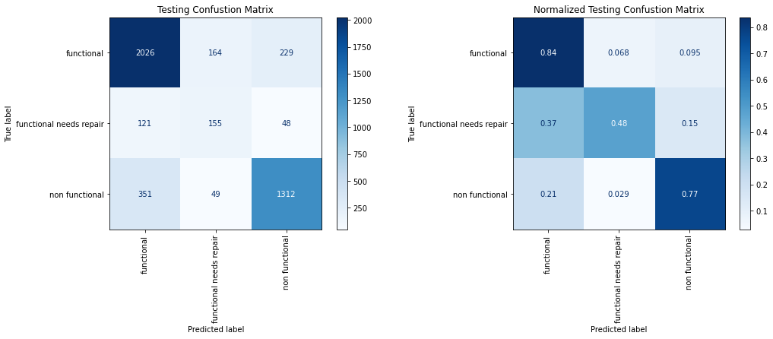
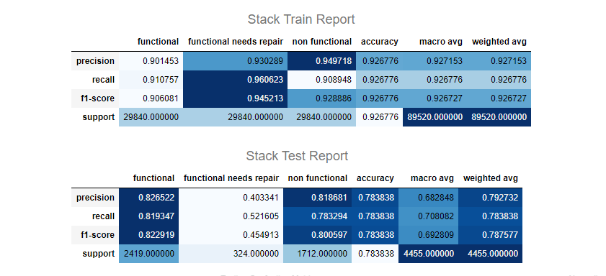
Model Evaluation

Slide 6
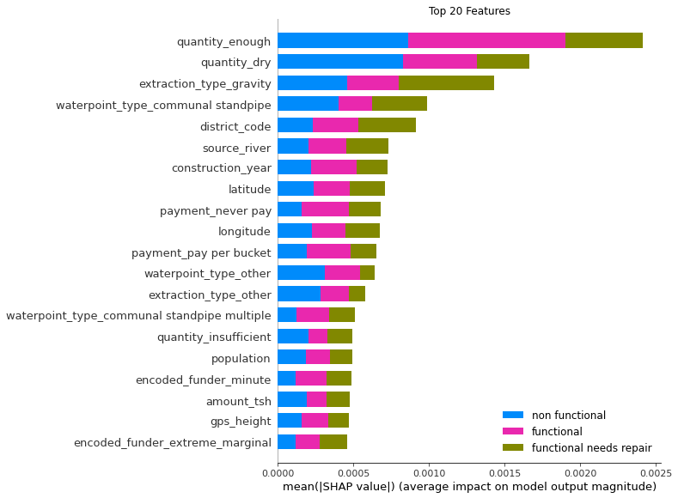
Overall Feature Importance

Slide 7
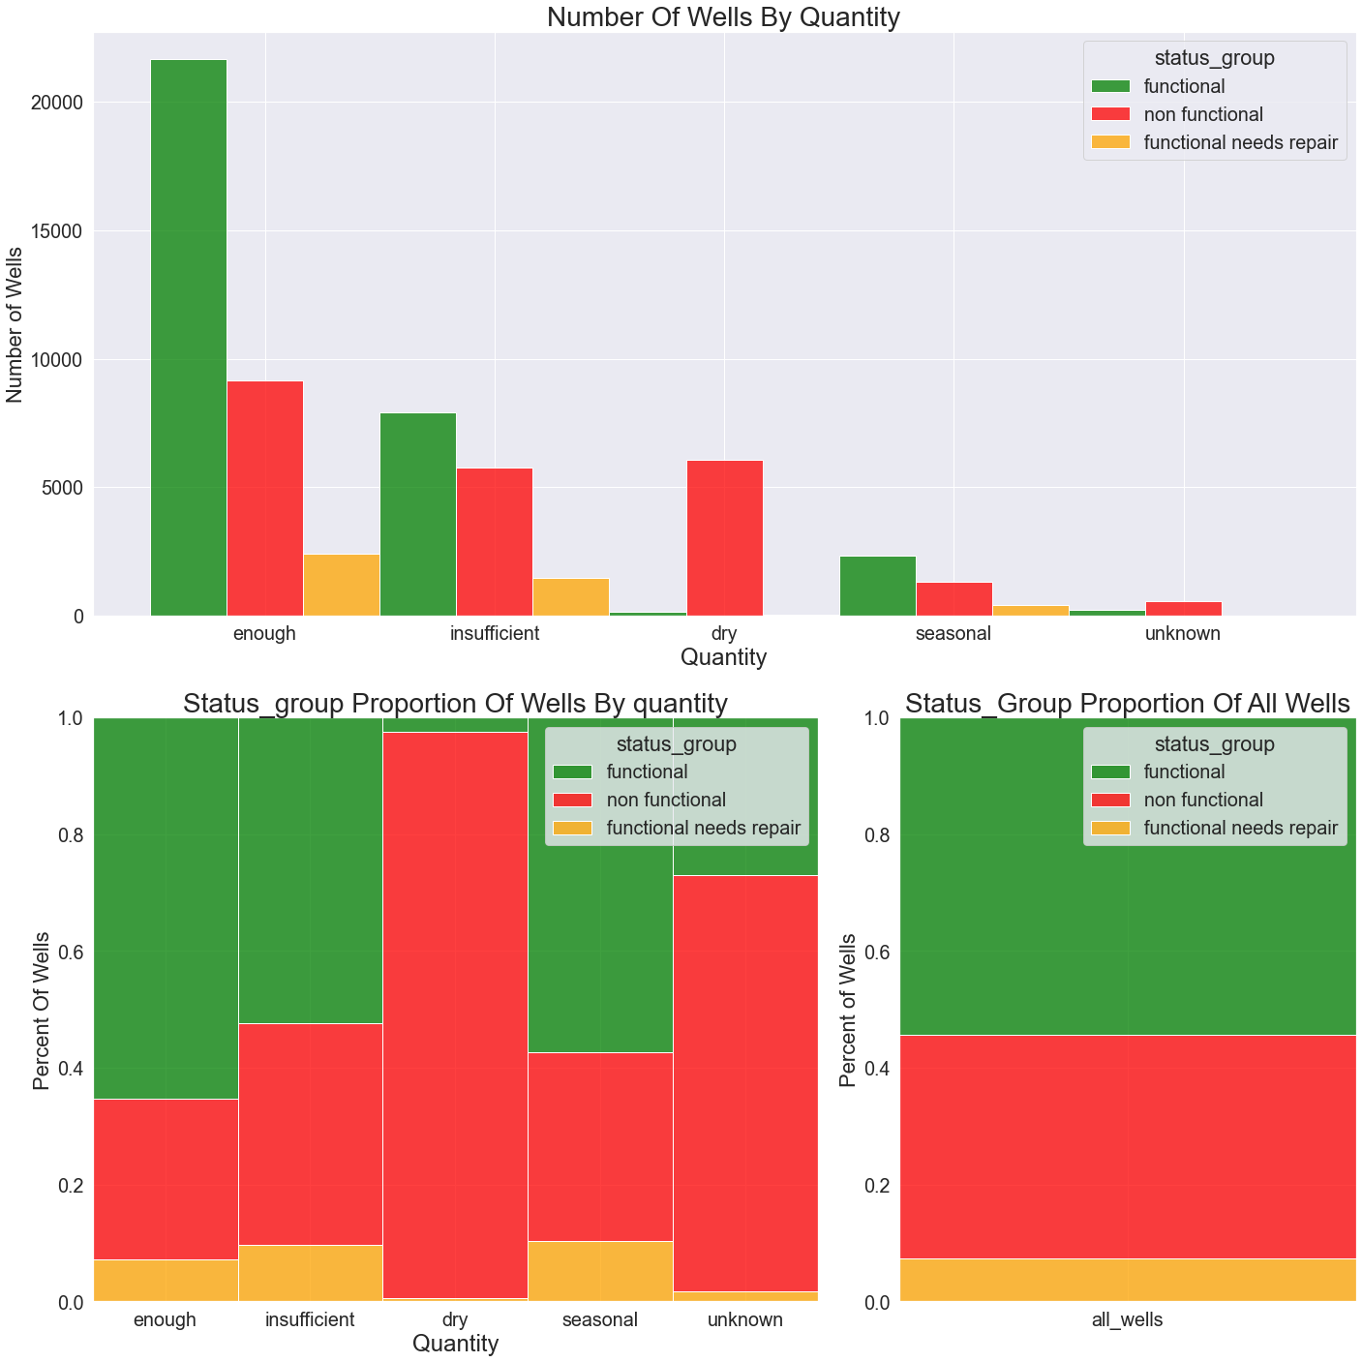
Feature Importance
Recommendations:
Additional site analysis before building or rebuilding wells that are labelled (or likely to be labelled) dry.
If wells must be built in areas that are likely to run dry, perhaps alternative water sources should be explored
Dry wells are highly likely to be non-functional
Enough quantity wells lean towards functionality when compared to the average

Slide 8
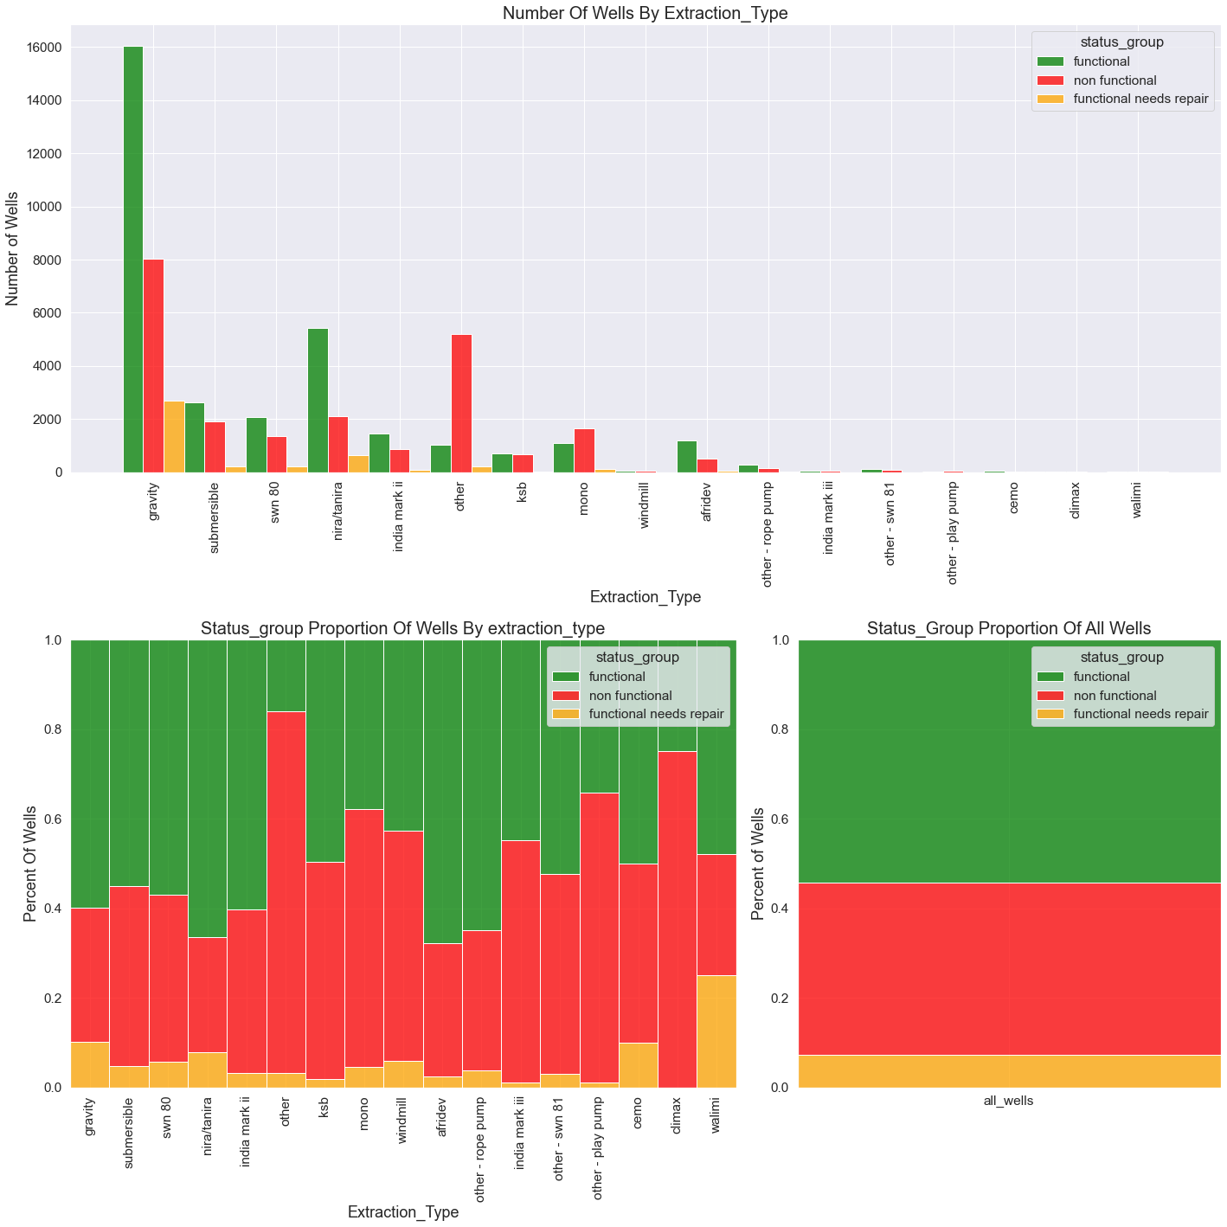
Feature Importance
Gravity wells are slightly more likely to be functional than average, however, they are also more likely to require more maintenance.
Other type wells are incredibly likely to be non-functional
Recommendations:
New builds should avoid well types that would fall under the other category.
Retro-fit old wells that are other type if possible.
Gravity wells should be reconsidered as the primary well extraction type due to maintenance issues.

Slide 9
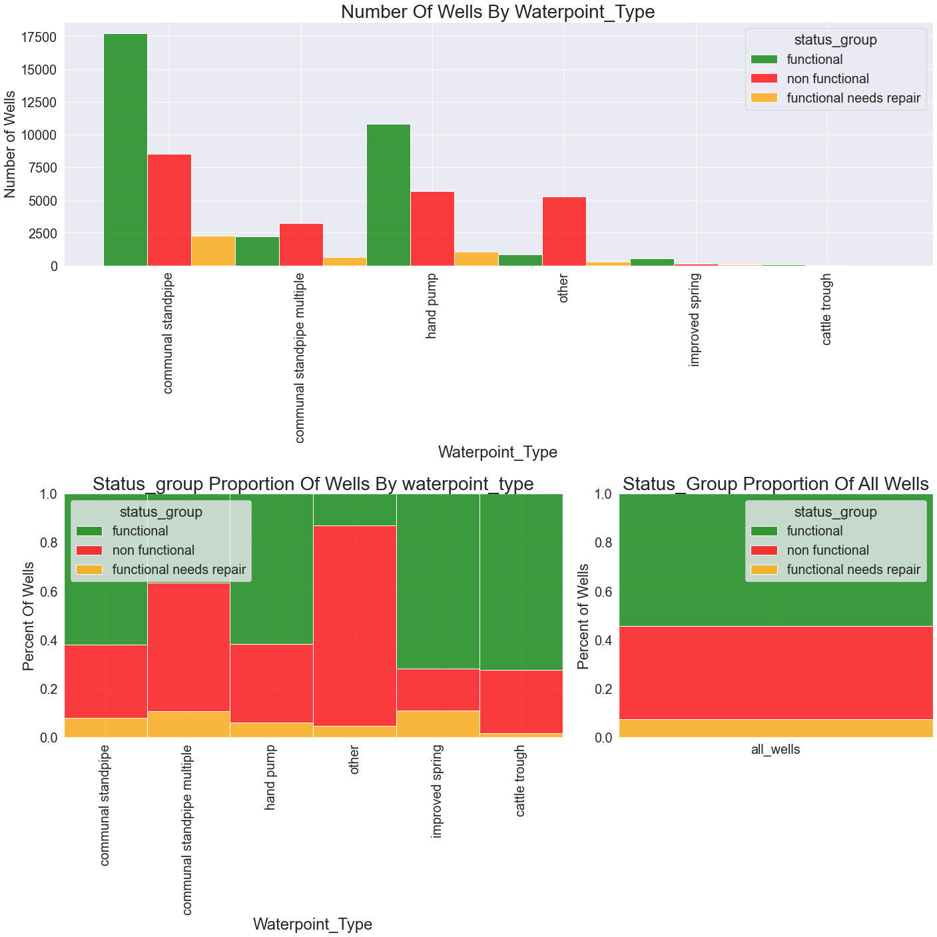
Features Importance
Communal standpipe appears to have a slight inclination towards functionality
Communal standpipe multiple and other types are heavily biased towards non-functional.
Recommendations
New builds and retro-fits should avoid the communal standpipe multiple and other types as the waterpoint.

Slide 10
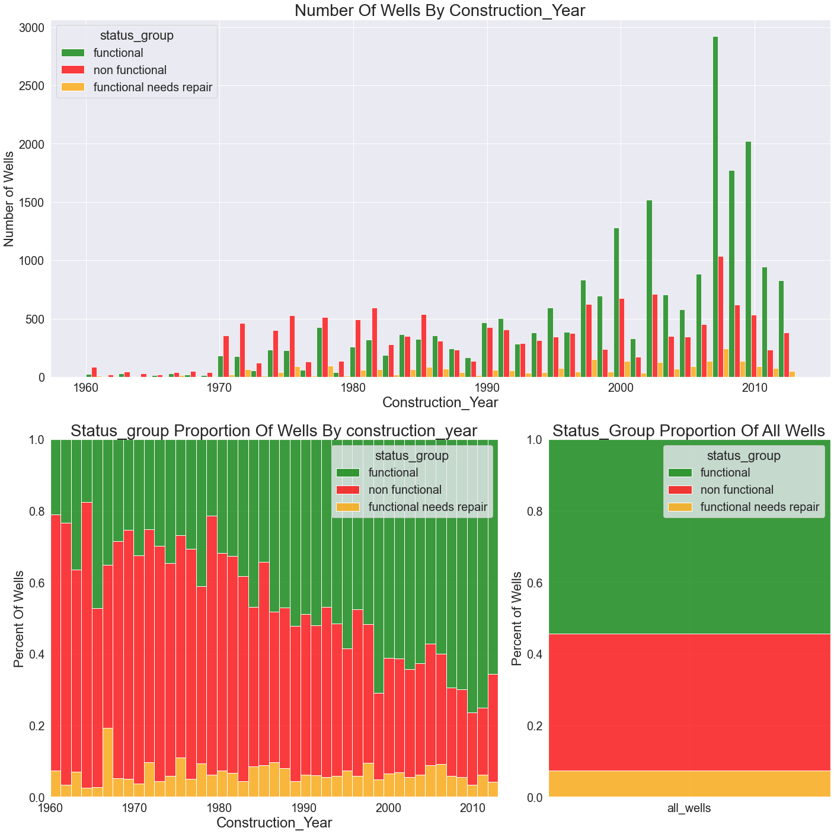
Feature Importance
Recommendations
Wells older than 1990 should be targeted for rebuilds
Wells constructed in the 1990s should be placed on maintenance schedules to limit additional non-functionality
Observation
Provides a loose roadmap for the aging pattern of modern wells.
Older wells are significantly more likely to be non-functional than newer wells.

Slide 11
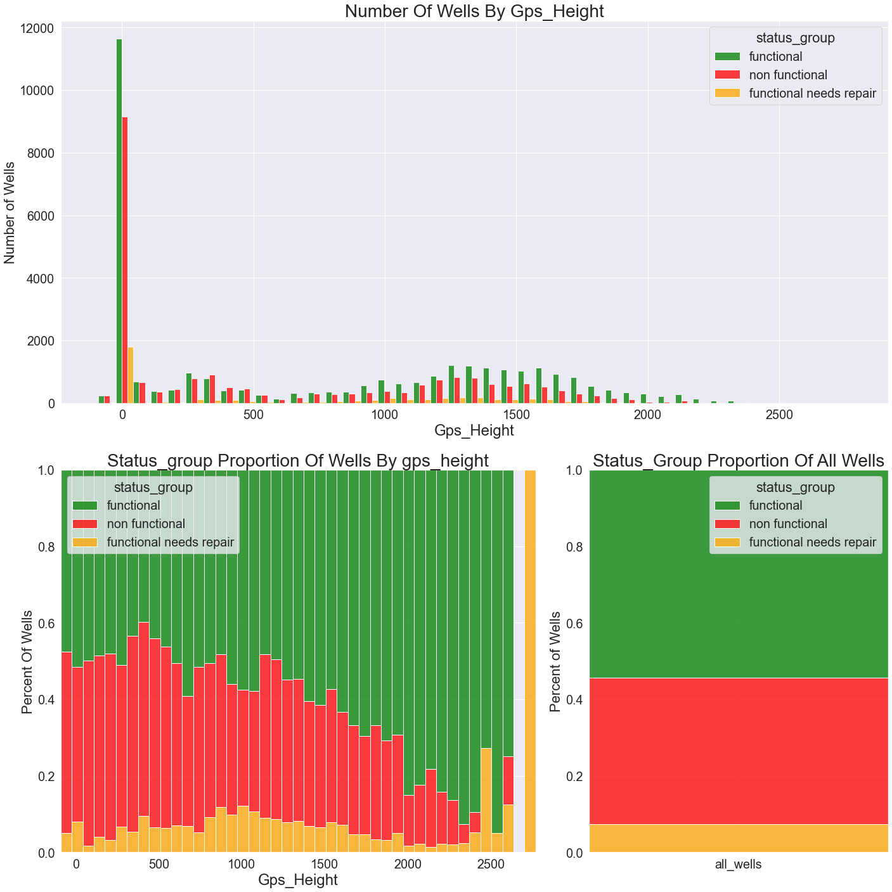
Feature Importance
Wells at higher elevation are much more likely to be functional than average.
Recommendations
When planning a well in any given area. Lean towards picking locations with higher elevations.

Slide 12
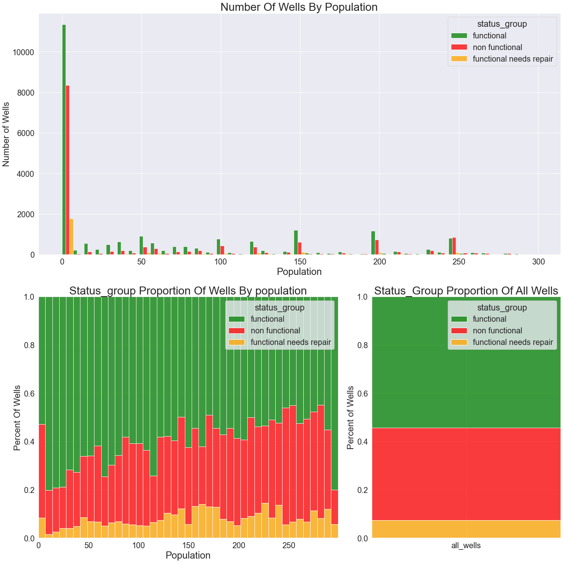
Feature Importance
Overall, the probability of wells being non-functional increases as population increases.
The notable exception is with the population being 0 or 1.
Recommendations
The sweet spot appears to be, 115 > populations > 8. Build wells near populations of this range.

Slide 13
Feature Importance
Certain clusters around the country are more or less likely to be functional.
Recommendations
Further investigate before adding or rehabilitating wells in non-functional clusters.

Slide 14
Future Work There’s still lots to do
Model Improvements
Use additional business and program insights to adjust feature engineering.
Experiment with additional imputation techniques rather than using a static fill value.

Slide 15
Thank you

